Slide 1
Reference title:
Site name
Project name

Slide 2
Content for a reference
DO/DON’T

Slide 3
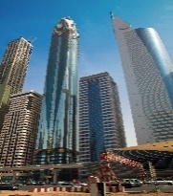
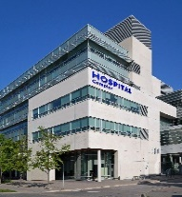
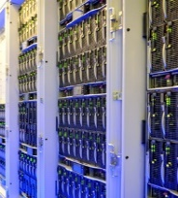
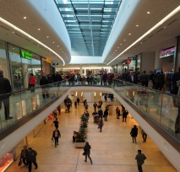
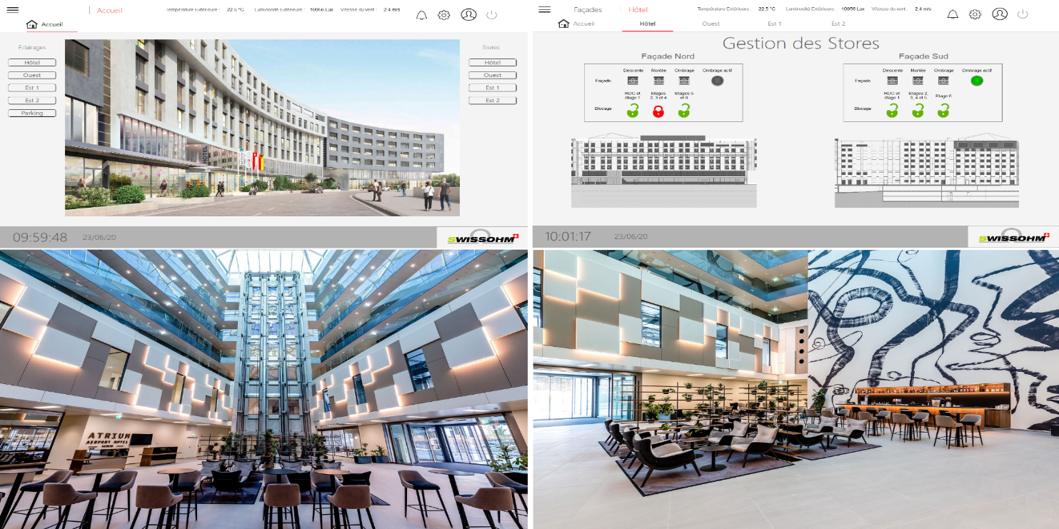
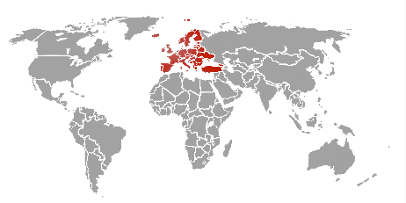
BMS
- Mall
TITLE:
Site or the customer
Project name
Meyrin - Switzerland
Check that names appearing in images are allowed by their owner
Project description
Instead of:
Describe the site activity with too much details
Not explain what PcVue does, how and for what benefits
Give too many technical details with no benefits
Prefer
Describe briefly what is the site activity and the context
Explain:
  What PcVue does?
  How is it done?
  What are the benefits for the customer?
Mention relevant figures if possible so the reader can compare
Technical properties
Indicate any relevant technical points that can demonstrate the benefits for the specific project
Ref Id : 2126

Slide 4
Example1
Instead of

Slide 5
BMS
- MALL
Redondancy
BMS Monitoring of lighting and blinds
What is the name of the site or customer?
Meyrin - Switzerland
PcVue retrieves information from KNX buses via Wago PLCs.
This centralized management via Wago automatons makes it possible to manage the entire infrastructure to control the blinds and lighting by geographic groups (manual, automatic and calendar actions).
1000 tags
1 Station
Smart Generator Wago
Utilisation des bibliothèques intégrées
Modbus TCP/IP
What are the benefits?
What is the area covered?
Ref Id : 2126

Slide 6
Example 1
Prefer

Slide 7
BMS
- MALL
Mall of “Meyrin 2”
Supervision of the lighting and blinds
Meyrin - Switzerland
Mall “Meyrin 2” is the 2nd largest mall of Switzerland with an area of 120 000m2
PcVue monitors and controls the blinds and lighting by geographic groups (manual, automatic and calendar actions).
All data are gathered in a centralized manner from KNX buses via Wago PLCs
The system allows the maintenance teams to manage the entire infrastructure very efficiently and ensure a high level of confort for occupants
1000 tags
1 Station
Smart Generator Wago
Utilisation des bibliothèques intégrées
Modbus TCP/IP
Ref Id : 2126

Slide 8
Example2
Instead of

Slide 9
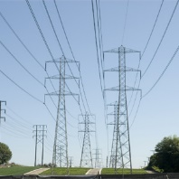


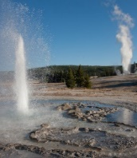
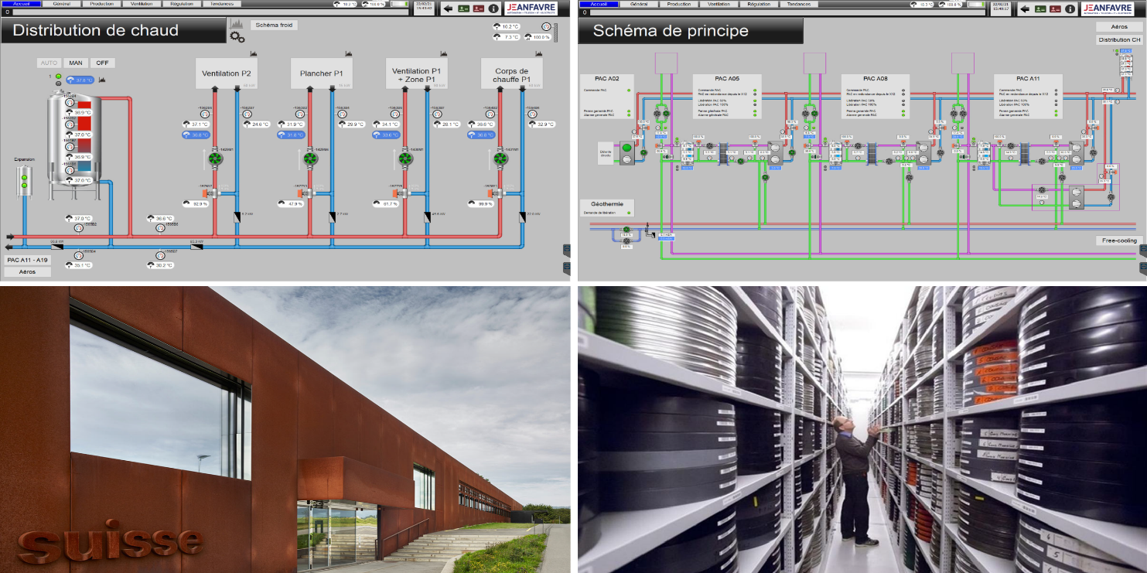
BMS
- Public building
Name may be under copyright
Cinémathèque Suisse
Version 12.0
What PcVue does?
What is the need for indicating the version?
Penthaz - Switzerland
Cinémathèque suisse is recognized by the International Federation of Film Archives (FIAF) as one of the ten most important film libraries in the world for the scope, diversity, and quality of its collections. Alongside 85,000 feature films and documentaries, the collection of Cinémathèque suisse includes thousands of hours of filmed documents of all kinds.
65000 tags
1 SCADA Complete + 2 WebVue
Data Export
Built-in Librairies
HVAC
Version 12.0
Wago (Modbus TCP/IP)
Description is too detailed
No mention of what PcVue does and what are the benefiits
Ref Id : 2302

Slide 10
Example 2
Prefer

Slide 11
BMS
- Public building
Name may be unauthorized
Cinémathèque Suisse
HVAC management system of the buidling
Penthaz - Switzerland
Cinémathèque suisse is one of the ten most important film libraries in the world for the scope, diversity, and quality of its collections.
The building covered 150 000m2 area.
PcVue monitors and controls the HVAC system for the entire building connecting Wago devices.
Maintenance teams access the system on a central control room and remotely using web access.
The system optimizes the energy consumed for air conditioning and allowed to reduce by 30% the consumption
65000 tags
1 SCADA Complete + 2 WebVue
Data Export
Built-in Librairies
HVAC
Version 12.0
Wago (Modbus TCP/IP)
Ref Id : 2302

Slide 12





Thank you for your attention
Arc Informatique
Phone:
Fax:
Mail:
Website: www.arcinfo.com
Manuel NAU
Schleitheimerstrasse 42a
Adress Line 3

