Slide 3
21 CFR 11 Presentation
Pharmaceutical companies must meet the requirements for the manufacture of new products and their responsibility for public health and safety.
Legal requirements such as those of GMP (Good Manufacturing Practice in Europe), the CFR (Code of Federal Regulation in the United States) and the FDA (Food and Drug Administration in the United States) led to emergence of frames of reference such as the 21 CFR Part 11 criteria and the GAMP (Good Automated Manufacturing Practice) for validation of automation systems in the pharmaceutical and medical fields.

Slide 4
21 CFR 11 Presentation
21CFR Part 11 is divided into 3 parts:
Stored data protection
Electronic signature
User Control

Slide 5
21 CFR 11 Presentation
Stored data protection:
1) Protection of process data
Keeping records on electronic format (please, refer to 21cfrpart11_final_rule.pdf §11.10 (b)).
Quick Review and possible extraction (11.10 (c)).
Closed system. Possible access to authorized persons. Automatic logout (11.10 (d)).
2) Audit traceability
-Any user action must be recorded in an traceable audit (11.10 (e)).
-Authorization Control (11.10 (g)).
3) Traceability of changes in software versions
-Version history (11.10 (k) (2)) .

Slide 6
21 CFR 11 Presentation
Electronic signature :
1) Signature unencrypted electronic records (Chapter 11.50)
- Any electronic record must contain:
  Name, name of signatory.
  Meaning of signature (approval, review, responsibility)
  Date and Time Record.
2) handwritten and electronic signature correlated (Ch. 11.70)
-The records and the signature are linked.
-The signature is protected to prevent his transfer to another record. It is protected against any signature modification.
-Any change of signature must be recorded.

Slide 7
21 CFR 11 Presentation
Electronic signature :
3) Electronic signature unique and not re-assignable (Chapter. 11.100 (a)).
-The electronic signature is unique to a person.
-An electronic signature is not reassignable to a person.
4) Safety not bio-metric (Chapter. 11.200)
-identification code and password for each user.
-Signature name and password for critical action (11.200 (a) (1) (i)).
-Automatic operator logout (11.200 (a) (1) (ii)).
-Double signature on desired action (11,200 (a) (3)).

Slide 8
21 CFR 11 Presentation
User Control (Cap. 11,300)
-Each combination password and identification code is unique and can not be re-used (11 300 (a)).
-Expiration name and user password (11 300 (b)).
-Traceability of fraudulent access attempts (11 300 (d)).

Slide 9
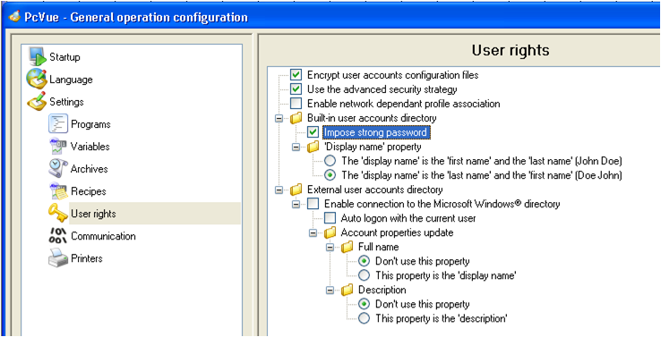
Users administration & access rights
Define into PcVue that you’re using advance security strategy .
Tick followings options in the General operation configuration.

Slide 10
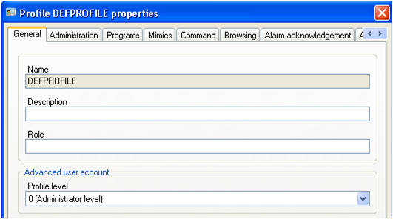
Users administration & access rights
Advance security strategy allows to define Profile level (from 0 to 9).
-Level 0 is the highest level linked to the administrator and can create users and profile of any level.
-User with level m (m>0) can see his profile but can’t modify it.
-User with level m can also view/create/modify users with level n (n > m).

Slide 11
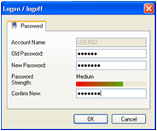
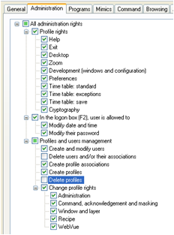
Users administration & access rights
Login and password are unique and must count 6 characters at least .
During his 1st connection, the user have to change his password.
Users and profiles created can not be deleted even by administrator.

Slide 12

Users administration & access rights
All fraudulent access attempts will be reported to the security officer on real-time .
Three internal variables indicate to the security officer a failed connection attempt:
-System.<StationName>.User.Trylogin is a text variable that contains the user login failed
-System.<StationName>.User.Rejected should be declare as an alarm of message type and will be set each time a failed login occurs.
-System.<StationName>.User.Numlocked is a register variable that count how many users accounts are locked
Note: System.<StationName>.User.Rejected variable will be set to 0 once the user acknowledge it.
Check the behavior in the 21CFR11 PcVue project.

Slide 13
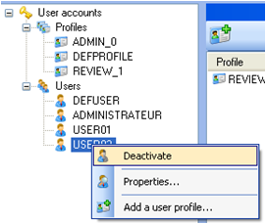
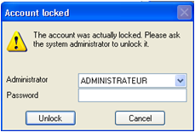
Users administration & access rights
It is possible to activate/deactivate a user account.
After 3 failed login attempts an account is deactivated and could be reactivated by a user with level 0 (Admin).
If the administrator identification is correct, then the account is unlocked, the administrator must give a new password for this user.

Slide 14
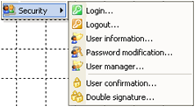
Authentication procedure
Many security animation are available to constrain the user authentication before an action.
Animation “User confirmation”
By using it you can require the user to:
Re-enter their password, enter an additional user name and password or re-enter their password and enter an additional user name and password before being allowed access to the control.
Check the behavior in the 21CFR11 PcVue project

Slide 15
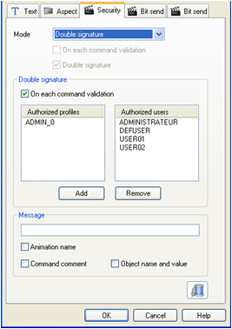
Authentication procedure
Animation “Double signature”
This animation forces the user to use both components of its signature (login and password).
As for the “User confirmation” animation, it is possible to ask a double signature on each command validation.

Slide 16
Authentication procedure
You can use the Security animation in conjunction with the following animations:
Send - Bit, Bit with color, Double bit, Register, Text, Recipe, Timetable and Region.
Run - Program, Macro and Application.
Link - Open, Close, Hyperlink and Note.
You can not use the Security animation for additional security when running a VBA script.
The Security animation must be applied to the support drawing element BEFORE the control zone animation.

Slide 17
Authentication procedure
Animation “User Information”
This animation displays the properties of the operator logged in (login, name, surname, title, comments) to be able to read sheet information operator in operation.
It is possible to allow selection of the user from the User Properties dialog displayed at run time.
Check the behavior in the 21CFR11 PcVue project

Slide 18
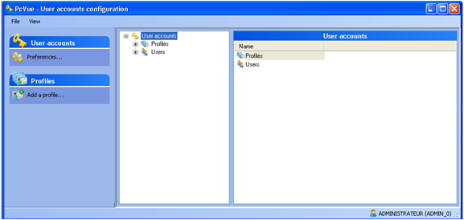
Authentication procedure
Animation “Password Modification”
This animation allows the current user to change its password.
Animation “User manager”
This animation launch the User Accounts Configuration tools.
Check the behavior in the 21CFR11 PcVue project.

Slide 19
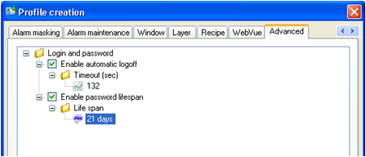
User rights management
To avoid any falsification attempt, an automatic logout function has been created.
This feature is configurable per user profile.
It is also possible to force a user to change their password after a configurable time.
To encrypt the file containing the profiles and user rights tick the encrypt user right option in the general operation configuration as shown at the beginning.

Slide 20
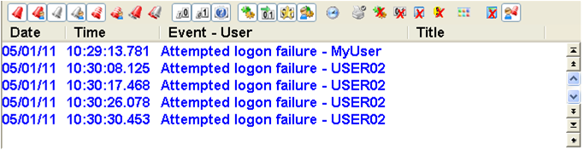
User rights management
All access attempts are stored in logs, even failed.

Slide 21
AUDIT Trail
To be able to find the characteristics of the current user in logged data or directly in a mimic, system variables allow to retrieve the properties of the current user.
System.<StationName>.User1.Login
(equal to SYSTEM.<StationName>.USER and USER)
System.<StationName>.User1.Comment
System.<StationName>.User1.Name
System.<StationName>.User1.Firstname
System.<StationName>.User1.Quality
System.<StationName>.User1.Profile
Note:
It is necessary to define the station “StationName“ in the Network Stations configuration menu before to let create automatically these variables by PCVUE32

Slide 22
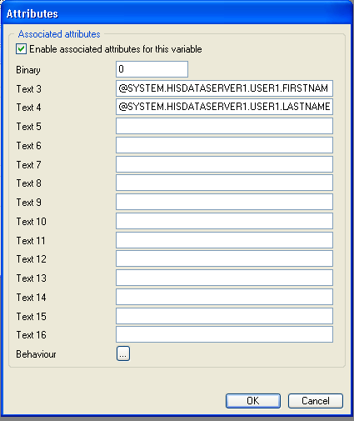
AUDIT Trail
You’ll find bellow an example using these variables
Note: Take care to save attributes 3 and 4 in the log list as deferred extended attributes.

Slide 23
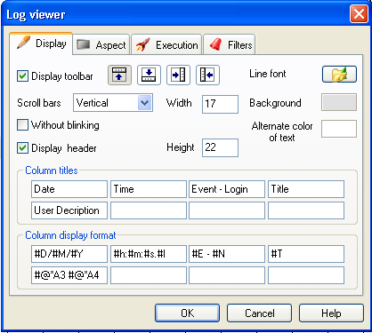
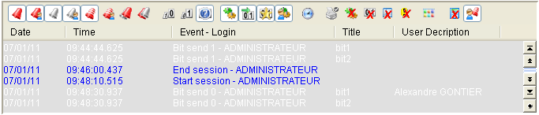
AUDIT Trail
Then by adding these information into the Log viewer
Check the behavior in the 21CFR11 PcVue project.

Slide 24
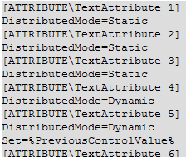
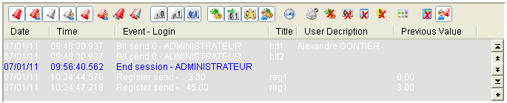
AUDIT Trail
By replacing User1 by User2 in the previous system variables, you will be able to Log the identified users’s information with the double signature animation.
It is also possible to log the previous register value when the user force it.
Do to it you have to manually update the Varconf.dat file as below
Add Set=%PreviousControlValue% after an extended attribute definition.

Slide 25
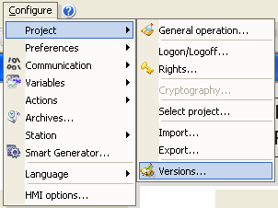
AUDIT Trail
Concerning the project update traceability, you can use Central Project Management available in the following menu.
This management allows:
- To define a unique number for each application updates
- To comment updates done in a specific version

Slide 26
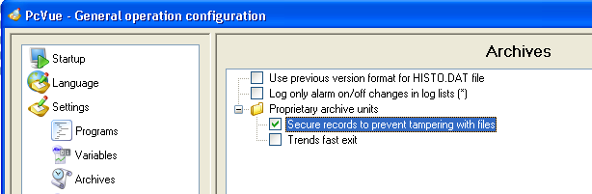
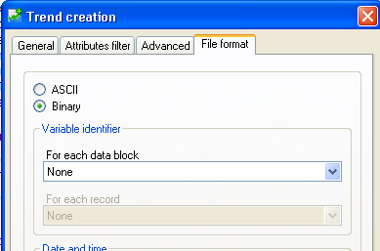
Historical Data
Activate the Cyclic Redundancy Check (CRC) on the archive unit.
Note: CRC is ONLY available for Proprietary archive unit.
During the Trend creation, take care to choose a binary File format.

Slide 27
Historical Data
By choosing a binary format the trend archive file isn’t readable by using a text editor.
Because the CRC is activated, any manual changes in the file will corrupt it.
It is also possible to deny access to this file by using windows users’ properties and files security.
To extract data from the file you have to use DataVue.

Slide 28
Conclusion

