Slide 1


Slide 2
BACnet, what is it ?

Slide 3
BACnet, what is it?
BACnet for:
Building
Automation and
Control network
BACnet® is a registered trademark of ASHRAE.

Slide 4
BACnet, what is it?
BACnet is a communication protocol for building automation and control networks.
BACnet defines the standard objects for building automation .
BACnet defines the functions for the access to these objects.
BACnet can be used by many standards and topologies networks (BACnet/IP).

Slide 5
BACnet, what is it?
BACnet is not a proprietary protocol.
BACnet is accessible without special license and can be implemented without paying duty.

Slide 6
Communication

Slide 7
Protocol &Transport Layers
BACnet Application Layer
BACnet Network Layer
TCP/IP
MS / TP
Dial-up
PTP
LonTalk
ETHERNET
RS 485
RS 232

Slide 8
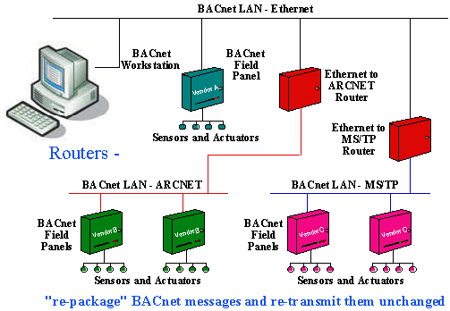
Multi Medium
The router allows to connect between différents
topologies, i.e. LonTalk to IP, MS/TP to IP, …
It limits the overloading of network.

Slide 9
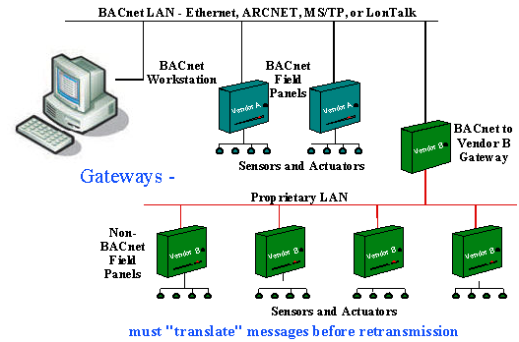
Multi protocols
The gateway allows the inteconnexion de BACnet to others protocols (Modbus, KNX, DALI…).

Slide 10
Data model

Slide 11
BACnet Objects
Objects represent physical inputs, outputs and software processes
BACnet has defined 25 standard objects.
  Accumulator, Analog Input, Analog Output, Analog Value, Averaging, Binary Input, Binary Output, Binary Value, Calendar, Command, Device, Event Enrollment, File, Group, Life Safety Point, Life Safety Zone, Loop, Multi-state Input, Multi-State Output, Multi-State Value, Notification Class, Program, Pulse-converter, Schedule, Trend Log

Slide 12
BACnet Device
A BACnet Device is a collection of objects.
Any BACnet Device includes a Device object
Device #1
Analog Input
Schedule
Analog output
Device
Analog Value
Loop

Slide 13
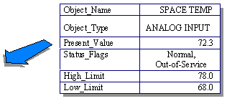

Object properties
All BACnet objects provide a set of properties used for retrieving object information or providing information and commands to the object.

Slide 14
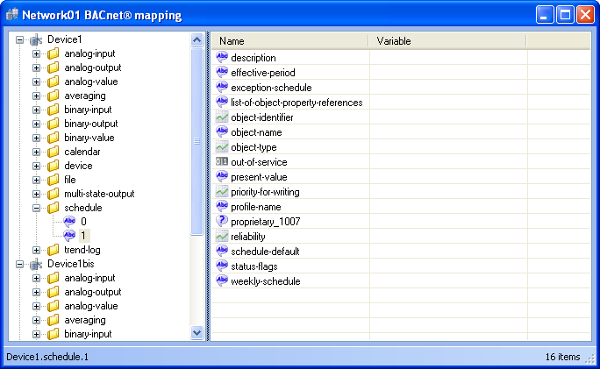
Object properties
Ex: properties of a schedule object

Slide 15
Schedule object
Allows to locally store schedule-program (weekly or exception schedule),
Allows to execute actions on a list of object references (analog-value, binary-output, …),
Can work in conjunction with the calendar object which may contain a date-list (of public-holidays) to disable the executing of schedule object.

Slide 16
Services

Slide 17
Application Services
BACnet has defined 6 classes of Application Services:
  Alarm and Event Services
  File Access Services
  Object Access Services
  Remote Device Management Services
  Virtual Terminal Services
  Security Services

Slide 18
Application Services
For example, the class “Object Access services” contains:
  ReadProperty
  ReadPropertyMultiple
  WriteProperty
  WritePropertyMultiple
  Time synchronisation
  …

Slide 19
PICS & Co

Slide 20
BIBBs
A BACnet Interoperability Building Block (BIBB) is a set of services (one or more) that execute a function or initiate a function.
The services of a BIBB can belong to different classes of application services.
Cf. Annex K

Slide 21
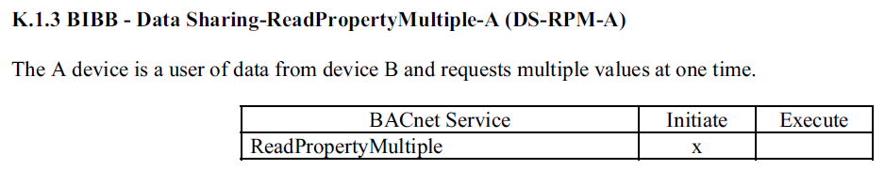
BIBBS

Slide 22
BACnet Profiles
B-OWS: BACnet Operator Workstation
B-BC: BACnet Building ControllerB-AAC: BACnet Advanced Application Controller
B-ASC: BACnet Application Specific Controller
B-SA: BACnet Smart Actuator
B-SS: BACnet Smart Sensor
Cf. Annex L

Slide 23
Standardized Device Profile
BACnet has standardized some device profile among which the BACnet Operator Work Station (B-OWS)
The Protocol Implementation Conformance Statement (PICS) describe the profile (BACnet capabilities) of a device that are implemented (objects, properties, BIBBs…).

Slide 24
B-OWS profile
Data sharing
Alarm and event management
Scheduling
Trending
Device and network management

Slide 25
PICS document
Protocol Implementation Conformance Statement.
Created by the manufacturer for a device,
Identifying the particular options specified by BACnet that are implemented in the device.
PICS BACnet of PcVue v10.0

Slide 26
BDS

Slide 27
BDS configuration
BacnetDataServer from NEWRON SYSTEM
Additional software component installed by PcVue installation.
Linked to a PcVue version.
This is a service.

Slide 28
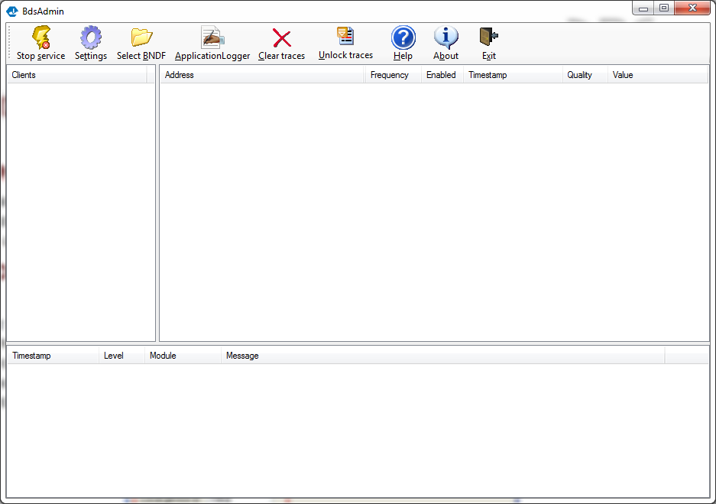
BacnetDataServer of NEWRON SYSTEM

Slide 29
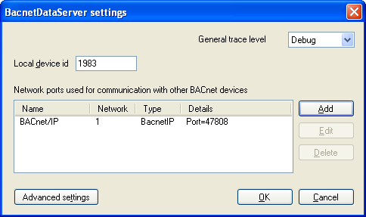
BDS configuration with BdsAdmin

Slide 30
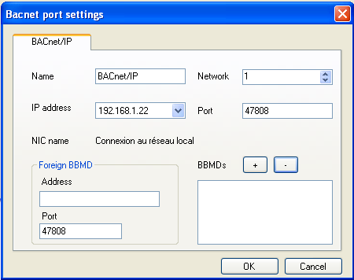
BDS configuration with BdsAdmin

Slide 31
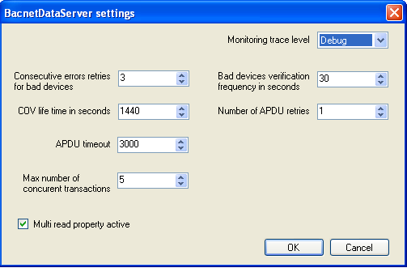
BDS configuration with BdsAdmin
Advanced settings

Slide 32
PcVue configuration (online)

Slide 33
BACnet configuration in PcVue
Creating of BACnet Network
BACnet scanner
Creating of a classical BACnet Device
EDE files format and import
Creating of BACnet Device from an EDE file

Slide 34
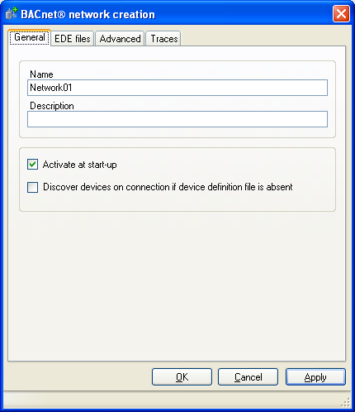
Creating of BACnet Network

Slide 35
BACnet scanner
Enable by creating the network (if the option is checked),
Enable by clicking on the button « refresh » from the device HMI,
Allows to display the containt of the mapping box,
Allows to complete the object, instance and property list-box to set the variable from the AIEplorer.

Slide 36
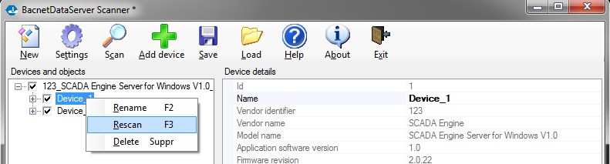
Browsing with BdsScanner
BdsScanner is a tool of NEWRON SYSTEM,
Use several scan modes which not yet implemented in PcVue (NoObjectsScan mode, NoPropertiesScan, …),
Allows to rescan a device only,
Allows to save the browsing configuration to a bndf format,
The bndf file can be used to the BACnet browsing in PcVue.

Slide 37
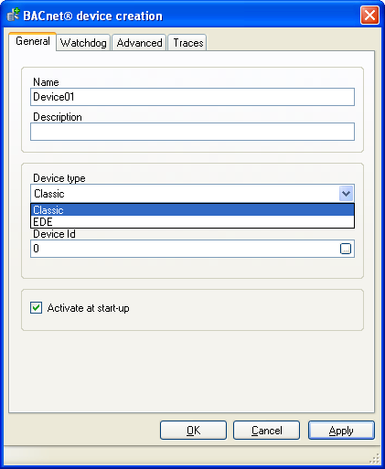
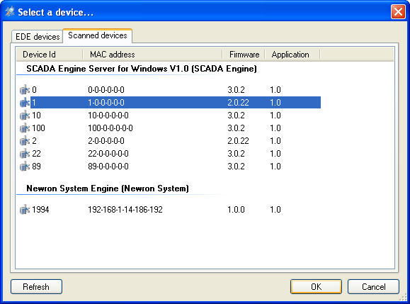
Creating of BACnet Device
From the interface of devices detected,
Manualy by setting the device id,

Slide 38
Mapping by object instance
A variable is mapped on an object instance
The variable is updated with a set of properties
Variable BACnet property
  Value -> present-value
  Timestamp -> change-of-state-time
  State -> status-flags (Fault flag)

Slide 39
BACnet variable status with the status-flags property
Status-flags property
Fault | In Alarm | Overridden | Out Of Service | PcVue result variable
0 | 0 | 0 | 0 | OK
0 | 0 | 0 | 1 | OK
0 | 0 | 1 | 0 | OK
0 | 0 | 1 | 1 | OK
0 | 1 | 0 | 0 | OK
0 | 1 | 0 | 1 | OK
0 | 1 | 1 | 0 | OK
0 | 1 | 1 | 1 | OK
1 | 0 | 0 | 0 | NS
1 | 0 | 0 | 1 | NS
1 | 0 | 1 | 0 | NS
1 | 0 | 1 | 1 | NS
1 | 1 | 0 | 0 | NS
1 | 1 | 0 | 1 | NS
1 | 1 | 1 | 0 | NS
1 | 1 | 1 | 1 | NS

Slide 40
Properties used for the mapping of BACnet instance
BACnet object type | property value | Timestamp property(*) | Quality property
analog_input | Present_Value | Undefined | Status_Flags
analog_output | Present_Value | Undefined | Status_Flags
analog_value | Present_Value | Undefined | Status_Flags
binary_input | Present_Value | Change_Of_State_Time | Status_Flags
binary_output | Present_Value | Change_Of_State_Time | Status_Flags
binary_value | Present_Value | Change_Of_State_Time | Status_Flags
multi_state_input | Present_Value | Undefined | Status_Flags
multi_state_output | Present_Value | Undefined | Status_Flags
multi_state_value | Present_Value | Undefined | Status_Flags
accumulator | Present_Value | Undefined | Status_Flags
life_safety_point | Present_Value | Undefined | Status_Flags
life_safety_zone | Present_Value | Undefined | Status_Flags
loop | Present_Value | Undefined | Status_Flags
pulse_converter | Present_Value | Undefined | Status_Flags
schedule | Present_Value | Undefined | Status_Flags
* If the “Use time provided by the device” option is checked

Slide 41
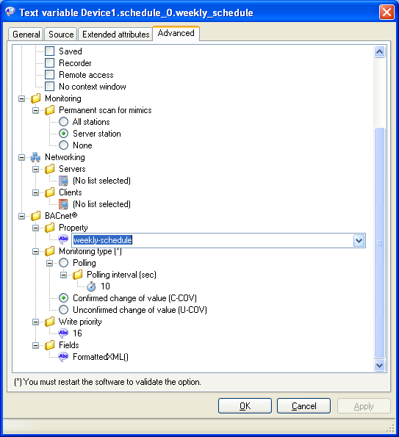
Mapping of BACnet property
For each instance of a BACnet object, it is possible to create a variable from a single property.
Creating from the mapping box.
Creating from the AIExplorer configuration box.

Slide 42
Monitoring

Slide 43
Monitoring type
3 types of monitoring :
Polling : The client reads the value of the property at the polling frequency set,
Cov : The client receives a notification from the server when the value has changed and sends an acknowledge,
UnCov : The client receives a notification from the server when the value has changed, and but without acknowledge.

Slide 44
Command

Slide 45
Writing a BACnet item
Some properties are writable and some properties are read only.
For some objects, the property present-value can be writable with a prioritization scheme.
In this case, 2 others properties are linked:
  priority-array: allows to define the 16 levels for priorization (1=highest, 16= lowest),
  Relinquish-default: its value is the default value of the property present-value when the priority-array is empty.

Slide 46
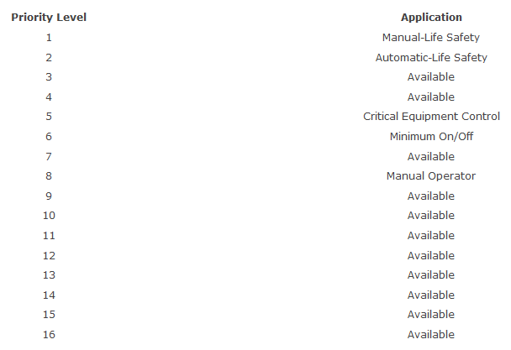
Priority array

Slide 47
PcVue configuration (offline)

Slide 48
What is the EDE format?
CSV file
A header of file
A line of fields (mandatory or optional)
A line with the header of columns
Data point columns
  Mandatory
  Optional

Slide 49
EDE file header
Project Name
Version Of Reference File
Time Stamp Of Last Change
Author Of Last Change
Version Of Layout
Limited Resources (optional)

Slide 50
Mandatory data point columns
keyname : unique name
device-object-instance: BACnet device address
object-name: value of object-name property
object-type: number of object type defined in BACnet standard
object-instance: number of object instance

Slide 51
EDE files
Allows to configure in off-line
Contains the description of one or more devices
To map an instance of BACnet object (present-value, status-flags, change-of-state-time)
It’s the keyname which is associated at the variable.
Example

Slide 52
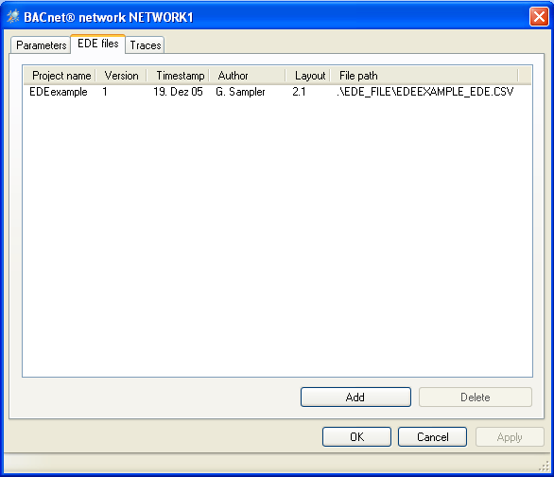
EDE file
It is necessary to reference the EDE file from the network properties.

Slide 53
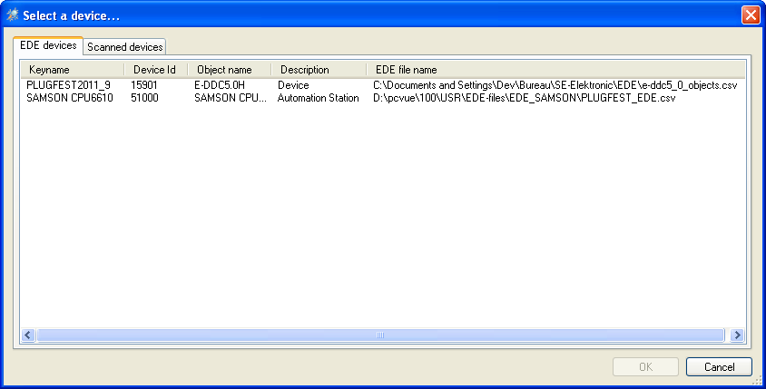
Creating of BACnet Device from an EDE file
All devices defined in the EDE-files imported will be displayed in the HMI.

Slide 54
Mapping EDE
Mapping by object instance only,
Object type and instance number automatically updated with the EDE-file.

Slide 55
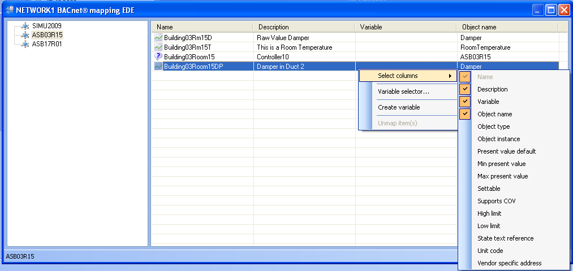
Mapping EDE

Slide 56
Smart mapper EDE
Supervisior’s database variable pre-filled automatically with the EDE-file informations
EDE field | property variable in pcvue
description | description
present-value-default
min-present-value | MinimumValue, DeviceMinimumValue, ControlMinimumValue,
max-present-value | MaximumValue, DeviceMaximumValue, ControlMaximumValue
settable | command
supports COV | monitoring type (*)
hi-limit
low-limit
state text reference | Reference at another file
unit-code | Reference at another file
vendor-specific-address
* If the choice is confirmed once by the custom box

Slide 57
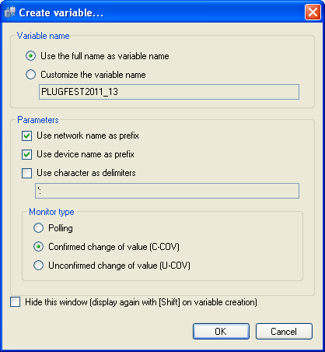
Customization with EDE mapping
At the first creating of variable and next if the option “Hide this window is unchecked, the pop-up menu displays:

Slide 58
Miscellaneous

Slide 59
Displaying a TXT value with XML format
Available for the TXT variable type
XML format is more readable than the raw format
Allows to write in a structured property like:
- weekly-schedule
- exception-schedule
- status-flags
- …

Slide 60
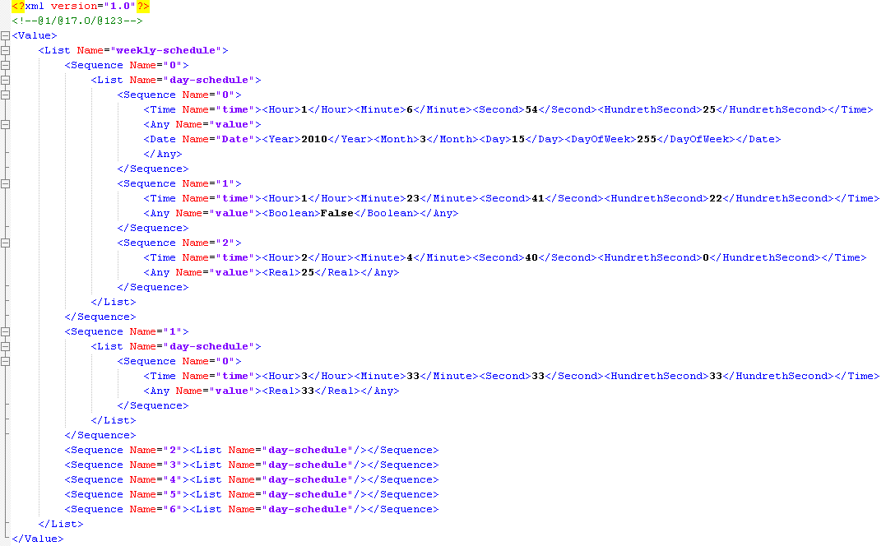
Example of XML format
Value of weekly-schedule property:

Slide 61
Time synchronization
From client:
  Local time synchronization
  UTC time synchronization
  Not synchronization from server

Slide 62
BACnet SCADA verbs
Time synchronization
Reset value by SCADA verbs
- Reset of the value at a priority
- Reset of values at all priorities
Write a value by specifying a priority
Start and stop by SCADA verbs
- Start of network
- Stop of network
- Start of device
- Stop of device

Slide 63
BBMD & FDT

Slide 64
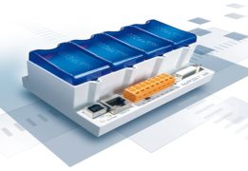

Sample of BACnet architecture with BBMD
Server PcVue 1
Ip : 192.168.1.11
Mask : 255.255.255.0
Address BACnet : 1
Table BBMD:
192.168.25.101
Automate 1
Ip : 192.168.1.12
Mask : 255.255.255.0
Address BACnet : 2
Table BBMD:
In this case, PcVue1 can transmit the identification of devices of the sub-network « Eth2 » to Automate1.
Eth 1
192.168.1.0
Automate 2
Ip : 192.168.25.101
Mask : 255.255.255.0
Address BACnet : 101
Table BBMD:
192.168.1.11
Automate 3
Ip : 192.168.25.102
Mask : 255.255.255.0
Address BACnet : 102
Table BBMD:
Router ethernet
Eth 2
192.168.25.0

Slide 65
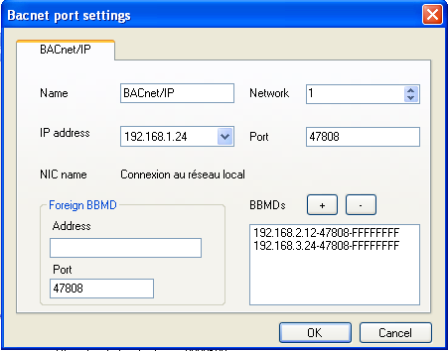
BBMD configuration with BdsAdmin

Slide 66
Sample of BACnet architecture with FDT
Server PcVue 1
Ip : 192.168.1.11
Mask : 255.255.255.0
Address BACnet : 1
Table BBMD:
192.168.25.101
In this case, PcVue1 is the only device in the sub-network « Eth1 ».
Eth 1
192.168.1.0
Automate 2
Ip : 192.168.25.101
Mask : 255.255.255.0
Address BACnet : 101
Table BBMD:
192.168.1.11
Automate 3
Ip : 192.168.25.102
Mask : 255.255.255.0
Address BACnet : 102
Table BBMD:
Router ethernet
Eth 2
192.168.25.0

Slide 67
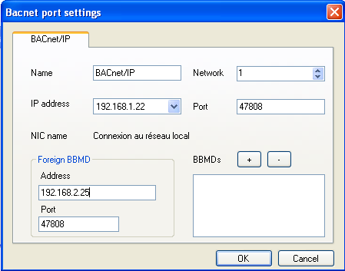
FDT configuration with BdsAdmin
To need to set the Foreign BBMD adress like below:

Slide 68
End

