Slide 1



ITM 2018
-Mobility-
Animated by Ling Ling Wu-Enzo PALOMBA-Grégoire CHOVELON

Slide 2




SnapVue Project –Workshop Goals & Summary
Application Family:
SnapVue (Get relevant information around you)
  Contextual information
TouchVue (Follow the information what you are interested in)
  Watchlists, Notifications
WebVue (WebVue as a Native app)
Account Manager (Central handling for all accounts of the Apps)
  No login needed on every startup (if desired so)

Slide 3
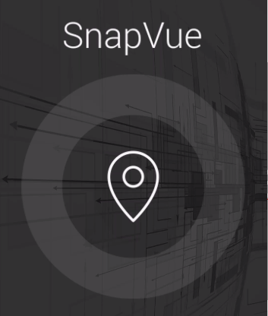
ITM 2018
-SnapVue-
The right information, to the right person, at the right place and at the right time

Slide 4
SnapVue Project –Workshop Goal
Workshop Goals:
Configure SnapVue from the Mobility Server side
Configure SnapVue from the mobile application side
How to set up a basic project with SnapVue

Slide 5
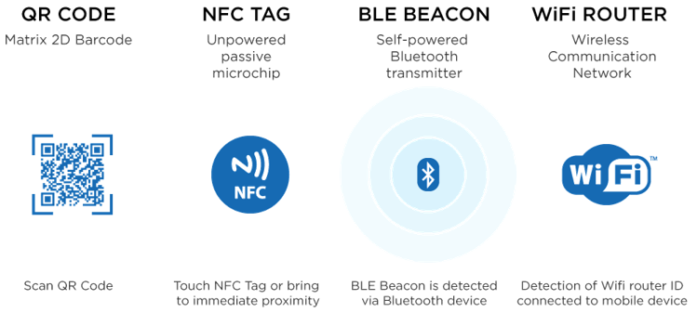
Location Based Services and Devices
Geolocation is how SCADA knows where the user and assets are while outdoors
  Using the GPS-adapter of the mobile device
Micro Geolocation is how SCADA knows where the user and assets are while indoors
  Beacons, Barcodes and NFC tell you what objects are nearby
  Geolocation tags identify where you are located in the facility

Slide 6

What we can do with SnapVue?
In the AE there is a set of shortcuts called Actions :
Set variable value action | Show log action
Show variable details action | Show symbol action
Show variables action | Show mimic action
Show trend action | Execute SCADA BASIC action
Show alarm action | Open URL action

Slide 7
What we can do with SnapVue?
Create a chat with the different users (text, photo or video)
Use the Tracking feature to follow the position of each mobile device (Map Control…)
The SnapVue application uses Responsive Design technology which allows an optimized adaptation of the display to the size of the screen

Slide 8
SnapVue In Practice…
How to set up a basic project with SnapVue?

Slide 9
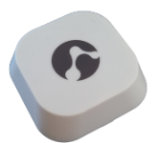


General Steps
Hardware preparation:
  Switch on a beacon (Beacon Stone) – Also deployable with SnapVue.
  Configure an NFC (NFCTools)
Mobility Server preparation:
  Install pcVue 12 & WDC & ETC folder
  Set up a PcVue project & create some users
  Launch services (« SvInstantMessaging » and « SvMobileServiceHost »)
  Connect it to your private network
  Check the IP-address/Hostname
Mobile device side:
  Enable Location/Bluetooth/ NFC and Wifi
  Connect to the same network as your Server
  Install and launch the mobile application on your mobile device
SnapVue application:
  Configure the server IP adress in the server section
  Log in with your credentials (When all statuses are green, everything is correctly set up)
  Go to the Migelo section to see some actions

Slide 10
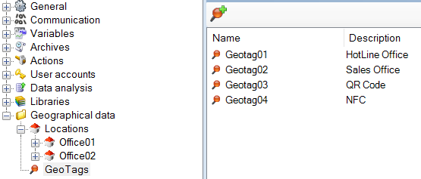
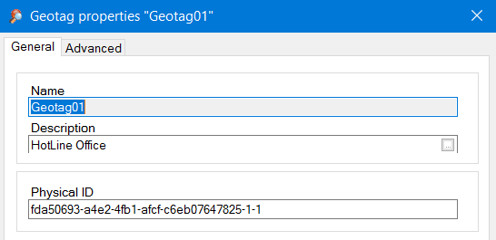
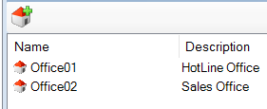
From the Mobility Server side
  Add some geo tags
  Define your tree of locations

Slide 11
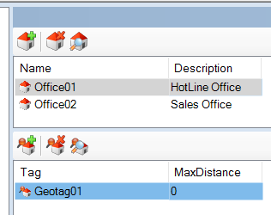
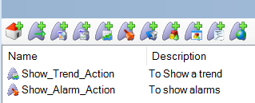
From the Mobility Server side
  Associate a Geotag to a location
  Create some actions in a location
  Connect your server to your private network

Slide 12
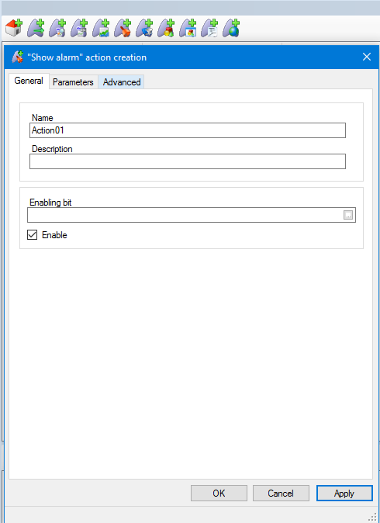
Creating an Action
Set up your base parameters
  Give a good description to identify
  what the action will do

Slide 13
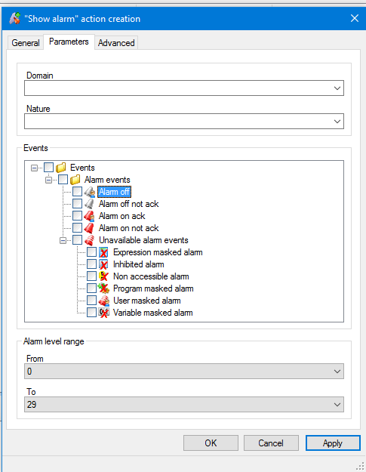
Parameters of an Action
Set up your parameters
  In case of Alarms add your desired
  filter of alarms

Slide 14
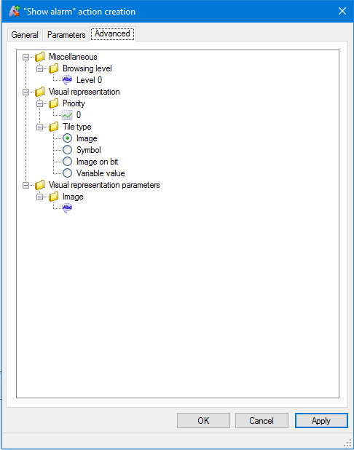
Visual layout
You have possibilities to customize
your action
  Custom Images
  Show Value of a variable
  Different custom images for bit values
  Show symbols on tiles

Slide 15
Dashboard
You have possibilities to display
a Dashboard
  All actions available
  Does not rely on geolocation
  Always displayed

Slide 16
From the mobile device side
Enable Bluetooth/ NFC and Wifi features and connect it to the server’s netwok
Install and launch the mobile application on your mobile device

Slide 17
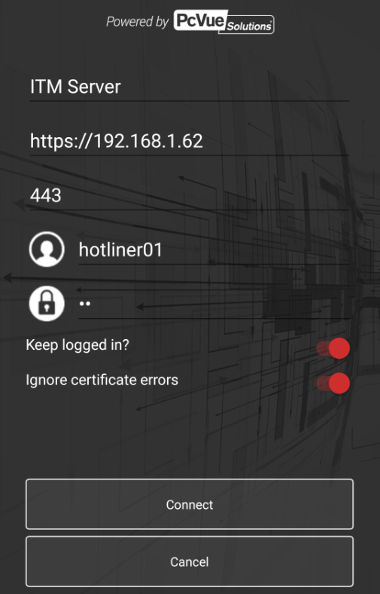
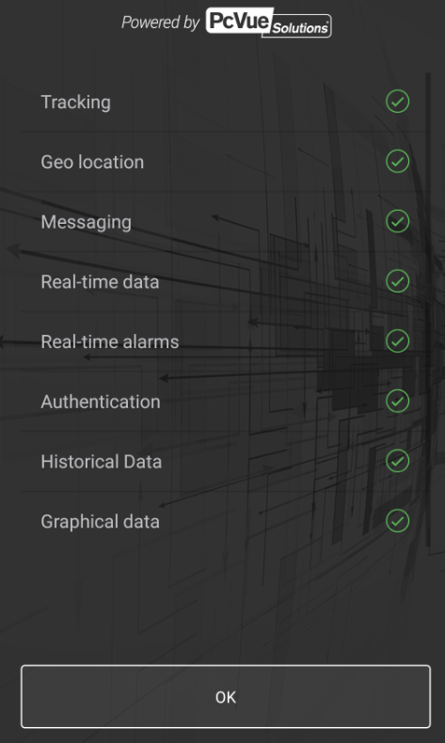
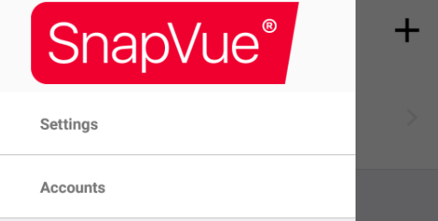
From the application mobile device side
In the Accounts section; configure the server IP adress and Log in with your credentials

Slide 18
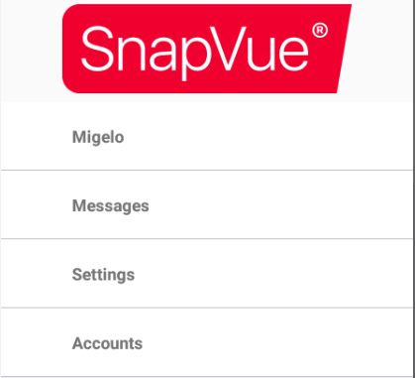
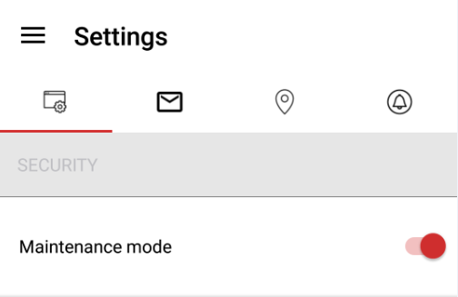
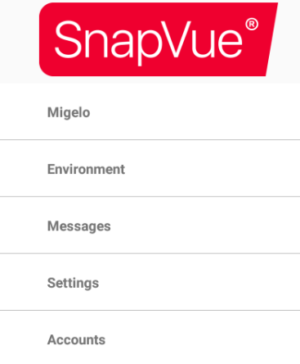
From the mobile device side
Activate « maintenance mode » and observe close tags detected around

Slide 19
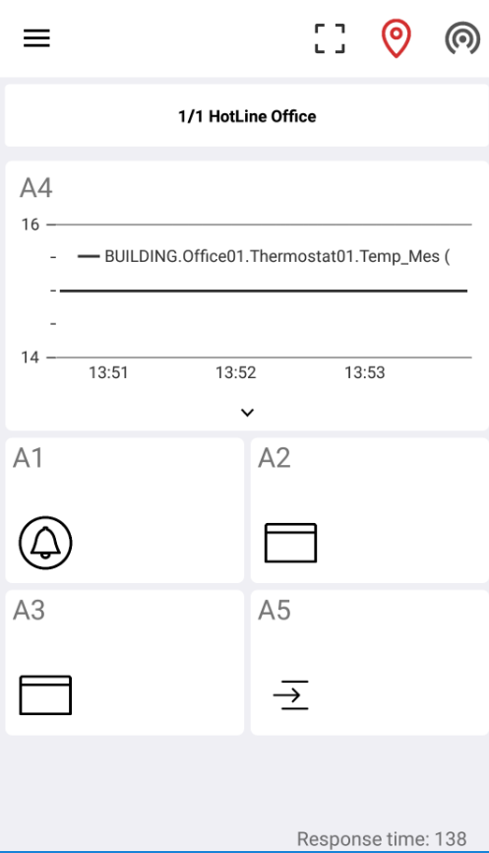
From the mobile device side
Switch on a beacon and go to the Migelo section to see some actions

Slide 20
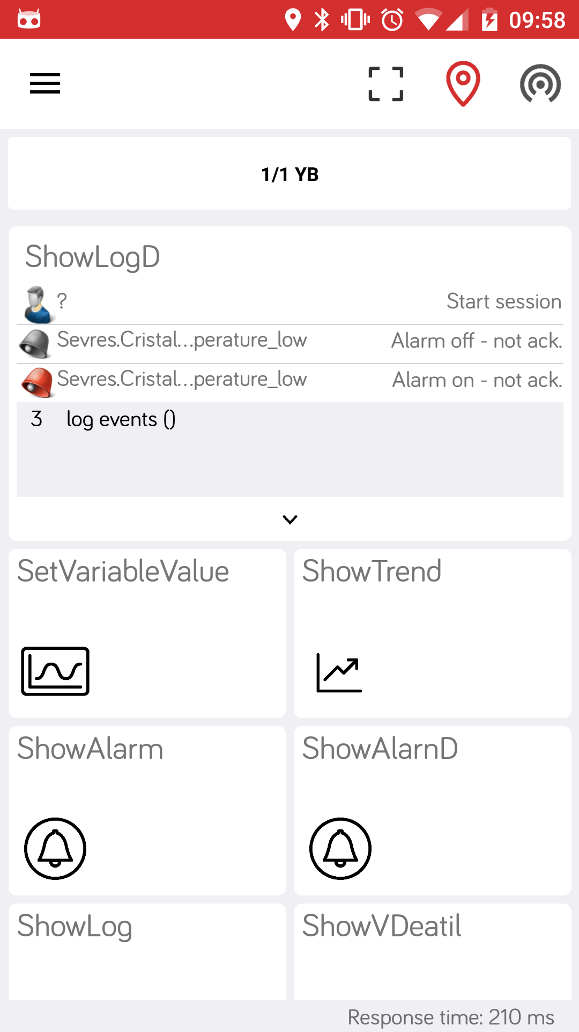
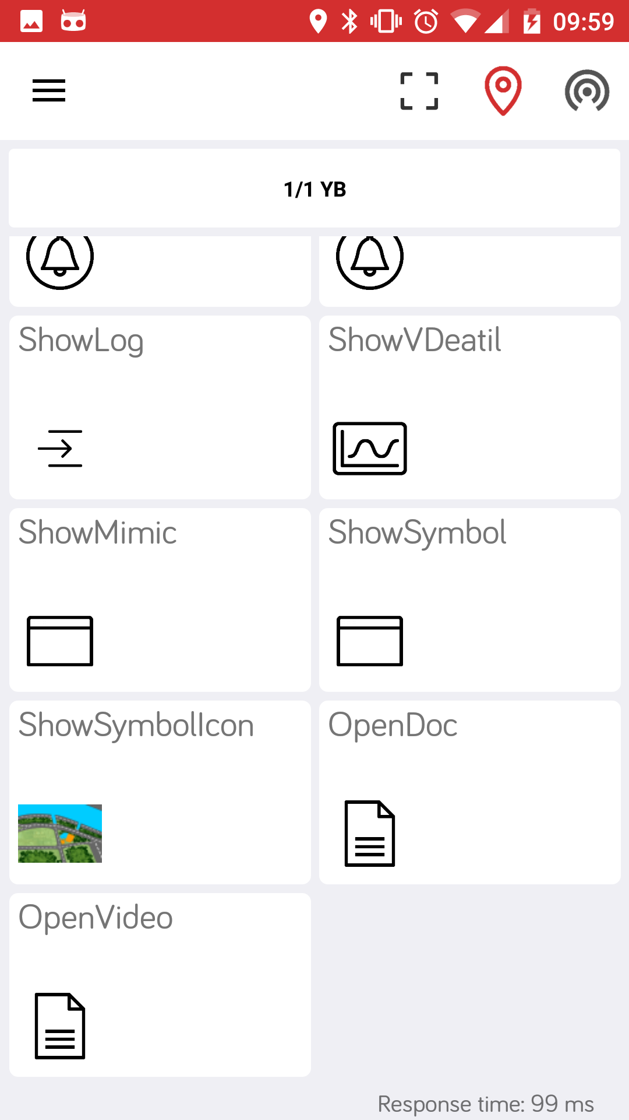
SnapVue Dashboard
Switch location
(if you want to see
something else than
your closest identified
location)
Your action with the
Highest priority will
be shown in a preview

Slide 21
Question / Answer

